Slide 1
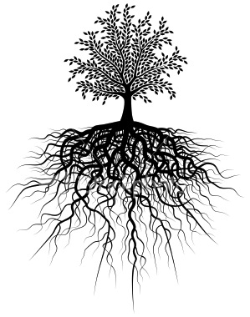
After 10 roots we will have a quiz!
Unit #1
Anti . De . A/an . Inter . Dis/di . Micro . Intra/intro . Medi . Pre . Post .

Slide 2
1. Anti = Against
Antibiotic
anti(against) bio(life) ic(characteristic of)
→ medicine used to kill living bacteria in the body
Antisocial
anti(against) soc(society) al(related to)
→ one who doesn’t like to be with others

Slide 3
2. De = Down
Descend
de(down) scend(climb)
→ to lower or go down
Demote
de(down) mot(move) e
→ to lower or go down in rank

Slide 4
3. A/an = not; without
Anarchy
an(without) arch(law) y
→ a state of chaos (no law)
Atheist
a(without) the(god) ist(one who)
→ one who believes that god does not exist

Slide 5
4. Inter = Between; Among
Interrupt
inter(between) rupt(break)
→ to break between two things
Intersect
inter(between) sect(cut)
→ to cut through / between two parts

Slide 6
5. Dis/di = Away; apart
Divert
di (apart) vert (turn)
→ to turn away from a path or direction
Disrupt
dis (away) rupt (break)
→to throw in confusion

Slide 7
6. Micro = Small
Microscopic
micro(small) scop(see) ic(characterisic of)
→ that which is too small for the human eye to see
Microbiology
micro(small) bio(life) ology(study of)
→ the study of small life forms

Slide 8
7. Intra/Intro = in; into
Introduce
intro(in; into) duce(lead)
→ to lead into something; to present something new
Introspection
intro(in) spec(look; see) tion(act of)
→ to think about oneself; a look inside oneself

Slide 9
8. Medi = Middle
Mediocre
medi(middle) ocre
→ used to describe something average
Median
medi(middle) an
→ the middle of a highway

Slide 10
9. Pre = Before
Precede
pre(before) cede(go)
→ to occur before something else
Prejudge
pre(before) judge = judge
→ to judge something before one should

Slide 11
10. Post = After
Postpone
post(after) pon(place; put)e
→ to move to a later time
Postmortem
post(after) mort(death/terror) em
→ anything regarding a body during the time after death

Slide 12
Use your knowledge of prefixes/roots/suffixes to tell me what I can’t remember.
It is the size in the middle….I can’t remember…What is it? ______
It’s when there is one ruler. It’s a mon______________.
I need another word for moving down. I can’t remember. ____________.
There are two prefixes for see…I can’t remember them. What are they?
I really don’t like homework. What is another way for me to say I am against homework?
I want to take a class where I study life. What should I take?
If I do really well in that class and decide to do that as a job, I would be called a what?

