Slide 1
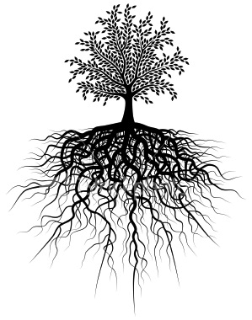
After 9 roots we will have a quiz!
Unit #6
vol,volu,voult . viv, vivi, vit . fid . nom, nomin, nomen . voc, vok. tract . hydr . cred. syn, sym, syl, sys

Slide 2
1. Volv, volu, voult = turn; roll
Revolve
re(again) volv(turn) e
→ to happen again in cycles
Convoluted
con(together) volut(turn; roll) ed
→twisted or coiled into something complicated

Slide 3
2. viv, vivi, vit = life
Revive
re(again; back) viv(life) e
→ to give life, energy, health, goodness back to
Vivacious
viv(life) ious(full of)
→filled with animation, and spirit; lively

Slide 4
3. Fid = faith
confide
con(together ) fid(faith) e
→ to trust another with private matters
Infidel
in(not; without) fid(faith ) el(one who)
→ one without religious beliefs
fid()

Slide 5
4. nom, nomin, nomen= name
binomial
bi(two) nom(name)i al (related to)
→ Consisting of or relating to having two names or terms
nominate
nomin(name) ate(to make)
→To propose by name as a candidate (for election)

Slide 6
5. voc, vok = voice
provoke
pro(forth) vok(voice) e
→ to stir to action or feeling
irrevocable
ir(not) re(back;again) voc(voice) able
→ impossible to revoke or take back

Slide 7
6. tract = draw; pull
contract
con(together) tract(draw)
→ an agreement between two parties or people
extract
ex(out) tract(draw; pull)
→to draw or pull out using great effort

Slide 8
7. hydr = water
rehydrate
re(again) hydr(water) ate (to make)
→ to put the water back into something
dehydrate
de(down) hydr(water) ate (to make)
→ to decrease or lessen the water content of something

Slide 9
8. cred = belief; believe
incredible
in(in; into) cred(believe) ible (able to )
→ not credible; hard to believe; unbelievable
credence
cred(belief) ence (characteristic of)
→ a confidence as true or valid

Slide 10
9. syn, sym, syl, sys = together; same
sympathy
sym(same) pathy(feeling)
→ understanding another feeling because you can imagine them
synonym
syn(same) o nym(name)
→ a word having a similar meaning as another

