Slide 1
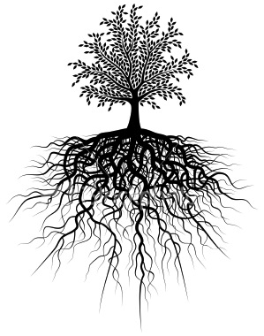
After 10 roots we will have a quiz!
Unit #5
Grad/Gress . Mal . Path/Pathy . Chron . Flu . Ped/Pod . Acros . Ject . Per

Slide 2
1. grad/gress = step;go
Aggressive
ag(to;towards) gress(go) ive(quality of)
→ you approach things forcefully
Progressive
pro(forward) gress(step;go)
→ bettering of a situation, ideas, etc.

Slide 3
2. mal = bad; poorly
Malfunction
mal(bad) =function
→ the act of functioning poorly
Malicious
mal(bad) ic(characterisitic of) ious(full of)
→ having evil intentions

Slide 4
3. Path/Pathy = feeling
Empathy
em(within) pathy(feeling)
→ understanding another’s feelings because you went through the same thing
Sympathy
sym(same) pathy(feeling)
→ understanding another’s feelings because you can imagine them.

Slide 5
4. Chron = Time
Chronological
chron(time) ology(study of) ic(characteristic of) al(related to)
→ looking at or relating to order by time
Synchronize
syn(same) chron(time) ize(to make)
→ to set at the same time; to do at the same time

Slide 6
5.Flu = flow
Superfluous
super(over; beyond) flu(flow) ous(full of)
→ Having too much of something or unnecessary
Influence
in(in) flu(flow) ence(quality of)
→to affect ones thoughts or overall self

Slide 7
6.Ped/Pod = Foot
Podiatrist
pod(foot) iatr(cure) ist(one who)
→ a doctor who specializes in foot care
Pedestrian
ped(foot) estri an(one who)
→ one who is walking on foot

Slide 8
7. Acro = High;tip
Acrophobia
acro (high) phobia (fear)
→ abnormal fear of heights
Acronym
acro (tip) nym (name)
→ a word formed from the initial letters of a name

Slide 9
8. Ject = Throw
Eject
e (out) ject (throw)
→ to forcefully send out
Project
pro(forward) ject(throw)
→ to throw forward or to direct on to

Slide 10
9. Per = Through; Thoroughly
Perspire
per(through) spire(breath)
→ to expel through external pores
Perfect
per(thoroughly) fect(do)
→ to complete the highest excellence of

