Slide 1
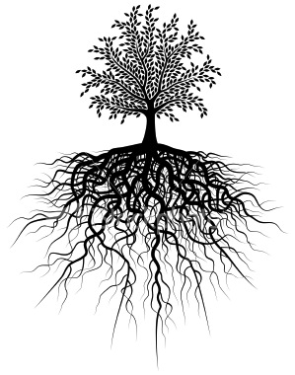
After 10 roots we will have a quiz!
Unit #4
un . dem/demo . gen . bio . gram/graph . sci . arch/arche . bel/bell . geo. fract/frag .

Slide 2
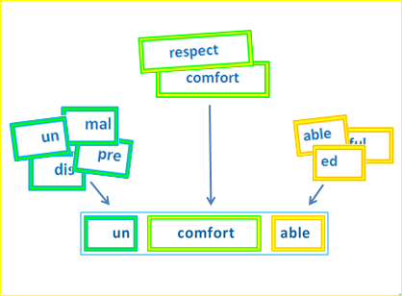
Parts of a Word
Root → A root and base word is a single word that cannot be broken into smaller words or words parts. Root words are words from which many other words are formed
Prefix → = a word part added to the beginning of a root word that changes it meaning
Suffix → A word part added to the end of a root word that changes its meaning

Slide 3
1. Un = not
Unarm
un(not) arm(to arm)
→ to get rid of weapons or ammunition
Unconscious
un(not) con(with) sci(knowledge) ous(full of)
→ not mentally aware (passed out)

Slide 4
2. dem/demo = people
Democracy
demo(people) crac(rule) y (result of)
→ rule of the people; leaders are voted for/ elected
Demographics
demo(people) graph(record) ic(characteristics of ) s
→ statistics about people in a given country/area

Slide 5
3. Gen = start / birth OR race / family
genocide
gen(start) cide(kill)
→ the systematic killing of a group (cultural, racial or political)
Genealogy
gen(birth) olog(study of) y (result of)
→ tracking your family’s history; family tree

Slide 6
4. Bio = life
Biosphere
bio(life) sphere(circle)
→ the region of earth (plus its outer atmosphere that supports life)
Biography
bio(life) graph(writing) y (result of)
→ a written account of someone’s life (written by someone else)

Slide 7
5.Gram/graph = record; write
Telegram
tele(distance) gram(write)
→ communication transmitted by wires that can travel a long distance
Phonograph
phono(sound) graph(record)
→A machine that reproduces sound from a disc (record player)

Slide 8
6.Sci = know / knowledge
Conscious
con(with) sci(know) ous(full of)
→ Aware; awake; understanding
Omniscient
omni(all) sci(know) ent(full of)
→ knowing everything there is to know

Slide 9
7. Arch / archae = rule; law; ancient
Archaic
archa(ancient) ic(characteristic of)
→ that which is very old (possibly out of date)
Archaeology
archae(ancient) ology(study of)
→ the study of ancient civilizations (digging in the earth to find artifacts)

Slide 10
8. Bel/ Bell = war; fight
Belligerent
bell(fight) ent(full of)
→ having war
Antebellum
ante(before) bell(war) um
→ a period of time before a war

Slide 11
9. Geo = earth
Geomorphic
geo(earth) morph(shape) ic(characteristic of)
→ of, or like the earth, its shape, or its surface
Geometry
geo(earth) metr(measure) y (result of)
→ the mathematics for solids, surfaces, lines and angles

Slide 12
10. Fract / Frag = break
Refractory
re(again) frac(break) ory(characteristic of)
→ stubborn; unmanagebale
Fracture
fract(break) ure(qualities of)
→ the condition of being broken; a break

