Slide 1
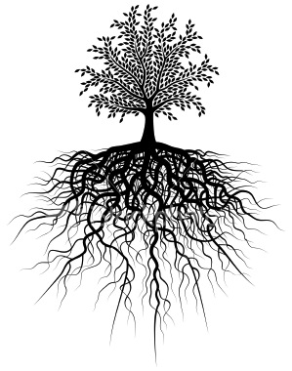
After 10 roots we will have a quiz!
Unit #3
Peri . Aqua . Retro . Cede / Ceed / Cess . Pro. Trans . Bene . Multi . Fleet / Flux . Para .

Slide 2
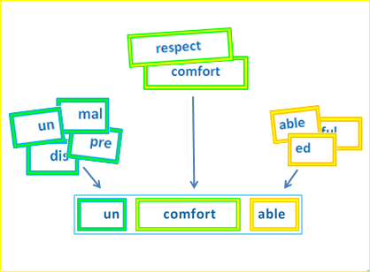
Parts of a Word
Root → A root and base word is a single word that cannot be broken into smaller words or words parts. Root words are words from which many other words are formed
Prefix → = a word part added to the beginning of a root word that changes it meaning
Suffix → A word part added to the end of a root word that changes its meaning

Slide 3
1. Peri = around
Periscope
peri(around) scope(look;see)
→ a submarine device that allows sailors to look in a complete circle
Periphery
Peri(around) pher(carry) y (result of)
→ an area beyond a specific location

Slide 4
2. Aqu / Aqua = Water
Aquarium
aqua(water) rium(place where)
→ a large area in which water and sea animals are confined so people can see them
Aquaduct
aqua(water) duct(to lead)
→ a place where water flows in a controlled way

Slide 5
3. Retro = Back (in time)
Retroactive
retro(back) act(to act; to do) ive (-)
→ applying a change to make it count at an earlier time
Retrospect
retro(back) spect(look;see)
→ to look back in the past

Slide 6
4. Cede/ceed/ces = Go
Recede
re (back) cede(go)
→ to go back or away from a certain place
Procession
pro(forward) cess(go) ion(act of)
→ the act of going forward – a parade

Slide 7
5. Pro = Forth; Forward
Promote
pro (forward) mot(move) e
→to contribute to the process of something or someone; to advocate in favor of
Proceed
pro(forward) ceed(go)
→to carry on after an interruption; to go forward

Slide 8
6. Trans = Across; Change
Transit
trans (across) it(travel; go)
→ a system of moving people from one place to another
Translate
trans(change) late(carry)
→to change speech; writing from one language to another

Slide 9
7. Bene = Good
Beneficial
bene (good) fic (to do) al (related to)
→ something that is good for you
Benediction
bene (good) dict (speak) ion (act of)
→ a blessing (typically at the end of a service)

Slide 10
8. Multi = Many
Multilateral
multi (many) later(sides) al (related to)
→ an object that has many sides
Multiple
multi(many) ple(fold)
→ more than one part

Slide 11
9. Flect / Flux = Bend
Reflect
re(back; again) flect(bend)
→ something that bends back (sunlight; reflection)
Deflect
de(down) flect(bend)
→ the swerve or turn a side; bend away

Slide 12
10. Para = Beside; Beyond
Paralegal
para(beside) leg(law) al (related to)
→ an assistant to a lawyer / law firm
Paranormal
para(beyond) norm (standard / usual) al (related to)
→ Beyond what is normal or expected

