Slide 1
After 10 roots we will have a quiz!
Unit #2
Re . Auto . Ab/Abs . Poly . Semi. Con/Com . En/Em. Non . Super . Ex .

Slide 2
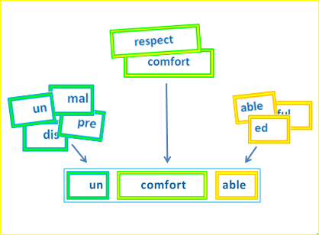
Parts of a Word
Root → A root and base word is a single word that cannot be broken into smaller words or words parts. Root words are words from which many other words are formed
Prefix → = a word part added to the beginning of a root word that changes it meaning
Suffix → A word part added to the end of a root word that changes its meaning

Slide 3
1. Re = Back; Again
Recognize
re(again) cogn(know) ize(to move)
→ to know someone or something from before
Reverse
re(back) verse(turn)
→ to go backwards; to change one’s opinions to the opposite side

Slide 4
2. Auto = Self
Automobile
auto(self) mob(move) ile
→ a vehicle that is self powered
Automotive
auto(self)mot(move) ive (causing/that which)
→ something (car) that works on it’s own; without human help

Slide 5
3. Ab/Abs = Away
Abduct
ab(away) duct(to lead)
→ to lead someone away / kidnap
Abnormal
ab(away) norm(usual) al (related to)
→ not acting in a usual or predictable manner

Slide 6
4. Poly = Many
Polytheism
poly(many) the(god) ism (belief)
→ belief in many gods
Polygamy
poly(many) gamy (marriage)
→ married to many

Slide 7
5. Semi = Half; Part
Semifinal
semi (part) fin (end) al (related to)
→The next to last round in a contest
Semiannual
semi (half) annu (year) al (related to)
→ Occuring twice a year

Slide 8
6. Con/Com = With; Together
Conductor
con(together) duct(to lead) or(that which)
→ a person who leads a group
Compose
com(with; together) pose(place;put)
→ to make something by putting parts together

Slide 9
7. Em/En= Inside; Within
Empathy
em(within) pathy(feeling)
→ understanding another’s feelings because you experienced the same thing
Encyclical
en(inside) cyclic(circle) al(related to)
→ intended to aid circulation

Slide 10
8. Non= Not
Nonverbal
non(not) verb(word) al(related to)
→ What which is done without words
Nonconformist
non(not) con(with) form(from) ist(one who)
→ Someone who does not do something in the typical way

Slide 11
9. Super = Above; Beyond
Supervise
super(Above) vis(look) e
→ To watch over; leadership position
Superior
super(beyond) (i) or(that which)
→ That which is better than the rest

Slide 12
10. Ex = Out
Export
ex(out) port(carry)
→ To sell goods to another country and transport them
Expel
ex(out) pel(drive)
→ To “kick out” from a group

