Slide 1
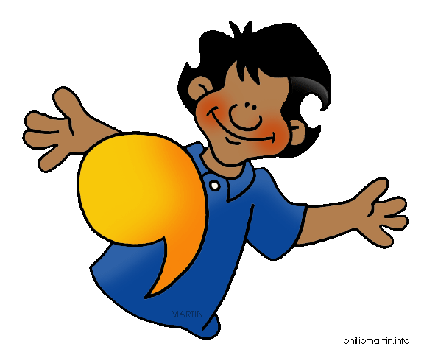
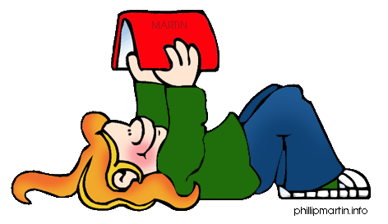
Grammar
Lesson 2:
Direct Objects

Slide 2
Grammar Vocabulary
Part of the Sentence
Part of Speech
Subject → Who or what a sentence is about
Predicate → starting with the verb, the rest of the sentence
Direct Object → (who or what) receives the action of an action verb
Phrase → a group of words that has a subject or verb, but not both
Noun → person, place, thing, (concrete) or an idea (abstract)
Pronoun → a word that takes the place of a noun
Verb → what is happening / action taking place

Slide 3
Day 1
Sub. Pred. Direct Object
James ate potatoes.
Sub. Pred. Direct Object
Cassia and Rachel played soccer.
Sub. Pred. Direct Object
Gavin kicked Peter.
Sub. Pred. Direct Object
Mrs. Bertrand bites her fingernails.

Slide 4
Day 2
Noun Verb Noun
Mrs. Bertrand taught lessons.
Noun Verb Noun
Samuel read Catcher in the Rye.
Noun Verb Pronoun
Tucker spotted him.
Noun Verb Pronoun
Peter hid him.

Slide 5
Day 3
Joe | loves football.
Scooby | loves Shaggy.
Ms. Keener | explains physics.
Ms. Milligan | swims laps.

Slide 6
Day 4
Pronoun She | Verb Pronoun hugs me.
Subject | Predicate Direct Object
Pronoun He | Verb Pronoun likes her.
Subject | Predicate Direct Object

