Slide 1
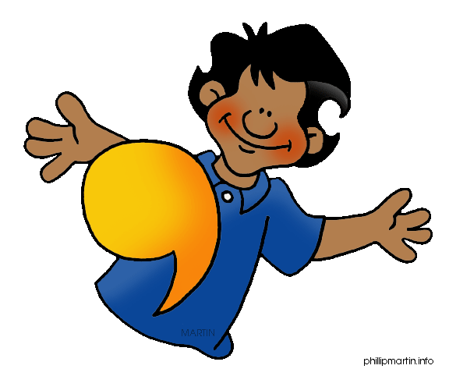
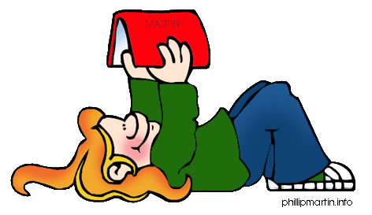
Grammar
Lesson 1:
Simple Sentences

Slide 2
Grammar Vocabulary
Part of the Sentence
Part of Speech
Subject → Who or what a sentence is about
Predicate → starting with the verb, the rest of the sentence
Noun → person, place, thing, (concrete) or an idea (abstract)
Pronoun → a word that takes the place of a noun
Verb → what is happening / action taking place

Slide 3
Day 1
Sub. Pred.
James ate.
Sub. Pred.
Cassia and Rachel played.
Sub. Pred.
He kicked.
Sub. Pred.
The dog bites.

Slide 4
Day 2
Noun Verb
Mrs. Bertrand taught.
Noun Verb
Samuel read.
Noun Verb
Tucker sees.
Pronoun Verb
She hid.

Slide 5
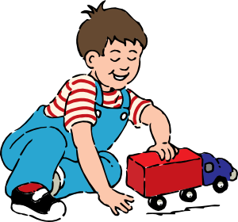
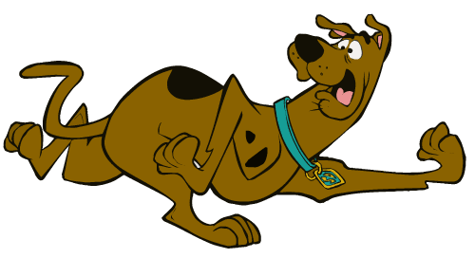
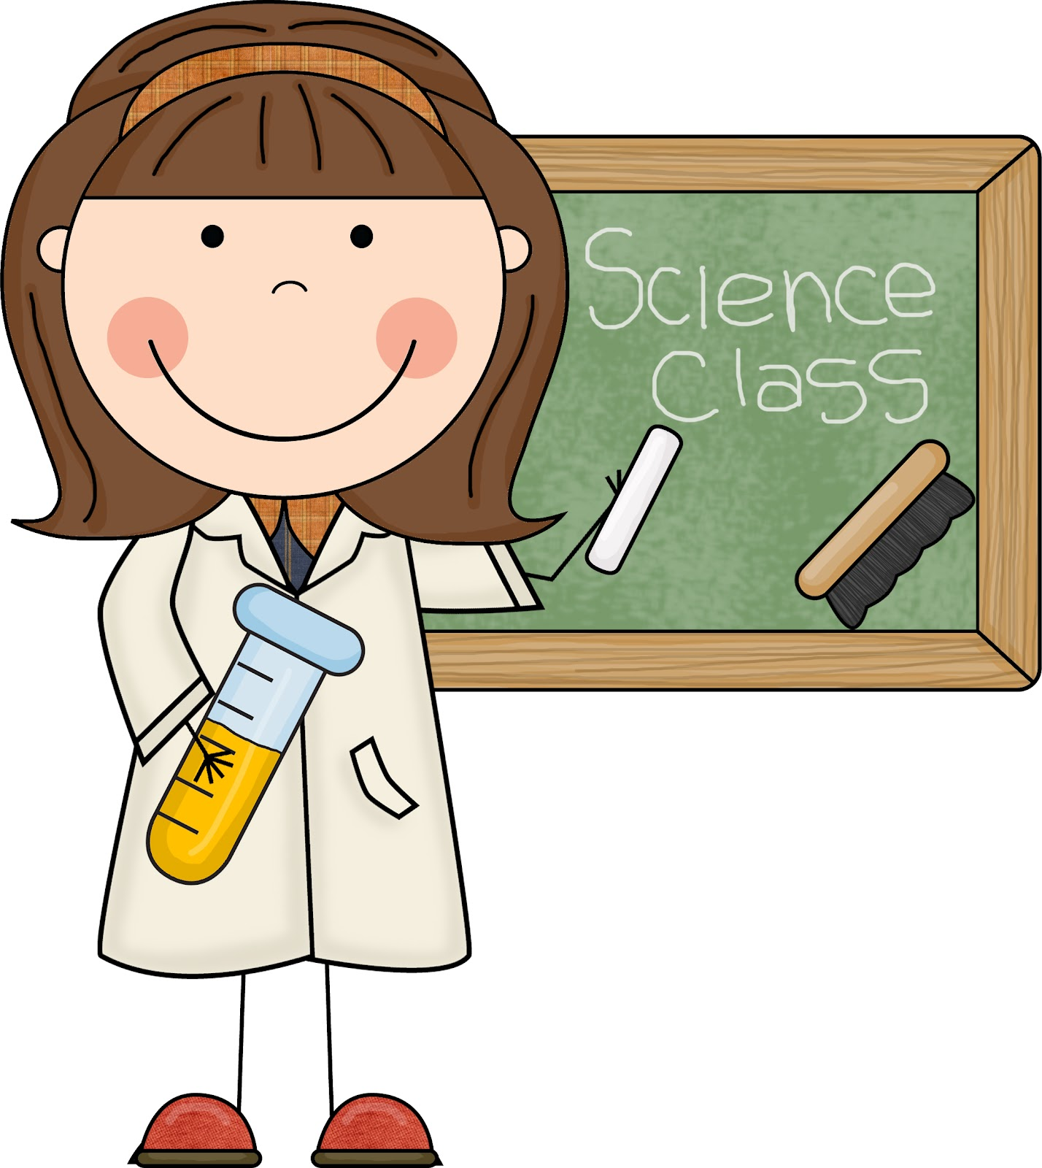
Day 3
Joe | plays.
Scooby | ran.
Ms. Keener | explains.
Ms. Milligan | swims.

Slide 6
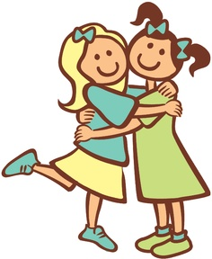
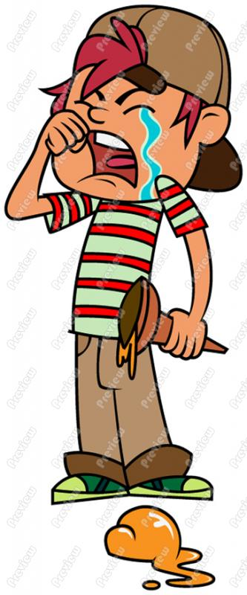
Day 4
Noun Sarah and Meg | Verb hug.
Compound Subject | Predicate
Pronoun He | Verb cries.
Subject | Predicate

