Slide 1
Figurative Language (Poetic Devices) Review
You have seen all of these types of Figurative Language before but let’s review what you already know ☺
Fill in the blanks – this is your study guide

Slide 2
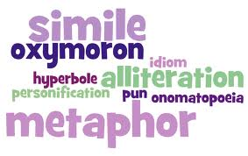
Figurative Language
Figurative language is language that uses words or expressions with a meaning that is different from the literal interpretation.
Literal language: something is simply stated
Figurative language: uses exaggerations or alterations to make the writing more interesting for the reader

Slide 3
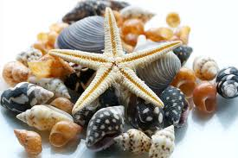
Alliteration
Alliteration - The repetition of the same initial letter, sound, or group of sounds in a series of words. Alliteration includes tongue twisters.
Example: She sells
seashells by the
seashore.

Slide 4
Cliché
Cliché - A cliché is an expression that has been used so often that it has become common and sometimes boring.
Examples: Opposites attract. You are what you eat.

Slide 5
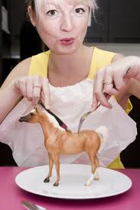
Hyperbole
Hyperbole - An exaggeration that is so dramatic that no one would believe the statement is true. Tall tales are hyperboles.
Example: I’m so hungry I
could eat a horse.

Slide 6
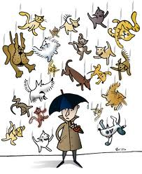
Idiom
Idiom - An idiom is an expression that has a meaning apart from the meanings of its individual words. It’s not meant to be take literally.
Example: It’s raining cats
and dogs.

Slide 7
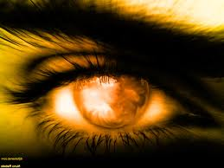
Metaphor
Metaphor - The metaphor makes a direct comparison between two unlike things. A simile would say you are like something; a metaphor is more positive - it says you are something.
Example: Her eyes are
stars shining in the sky.

Slide 8
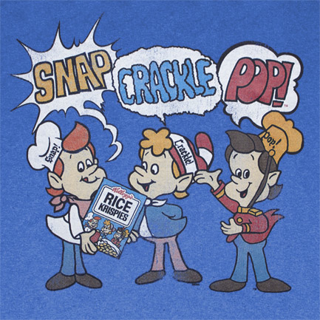
Onomatopoeia
Onomatopoeia – The use of a word to describe or imitate a natural sound or the sound made by an object or an action.
Example: snap, crackle,
pop.

Slide 9
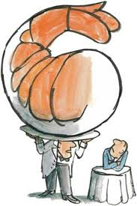
Oxymoron
Oxymoron – When something is described using contradictory terms.
Example: jumbo shrimp;
definite maybe;
deafening silence.

Slide 10
Personification
Personification - A figure of speech in which human characteristics are given to an animal or an object.
Example: My teddy bear
gave me a hug.

Slide 11
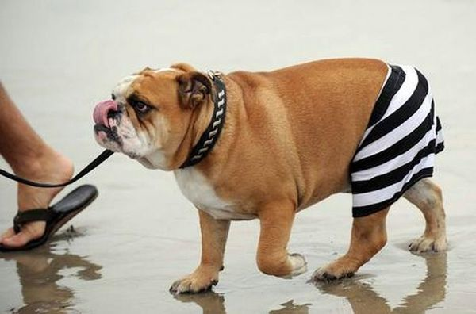
Pun
Pun – A play on words. A pun involves using a word or words that have more than one meaning.
Example: My
dog not only
has a fur coat,
but also pants.

Slide 12
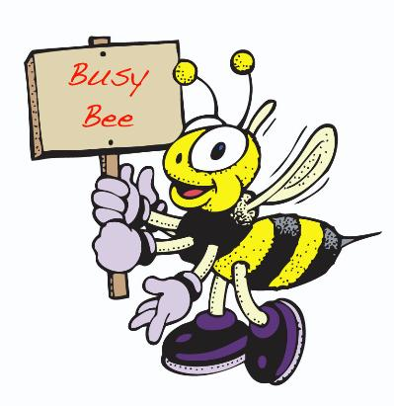
Simile
Simile - A simile uses the words “like” or “as” to compare one object or idea with another to suggest they are alike.
Example: She is busy
as a bee.

Slide 13
Figurative Language is all around us! Watch this short clip to see just how much figurative language is infused in our everyday life:
http://www.youtube.com/watch?v=8_QVhoLl_9U&feature=related

